Slide 1
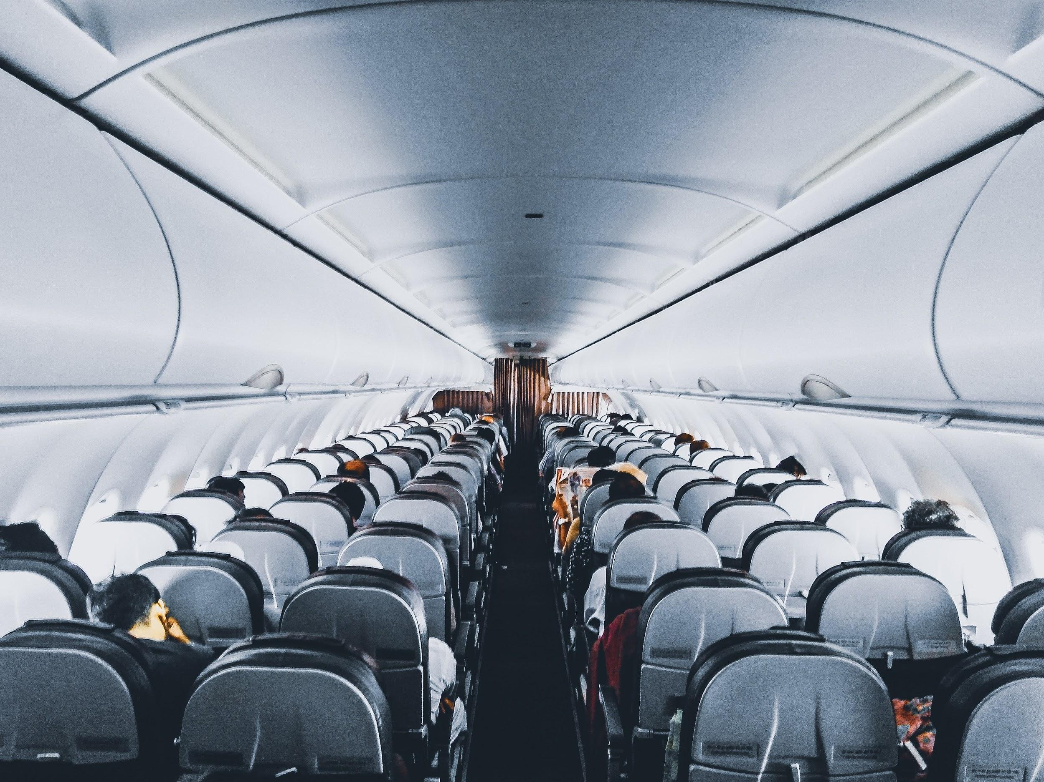
Flight delays and customer satisfaction
an empirical study
Mireia Suso
AllWomen, Data Analytics bootcamp Dec 2021
Final project

Slide 2
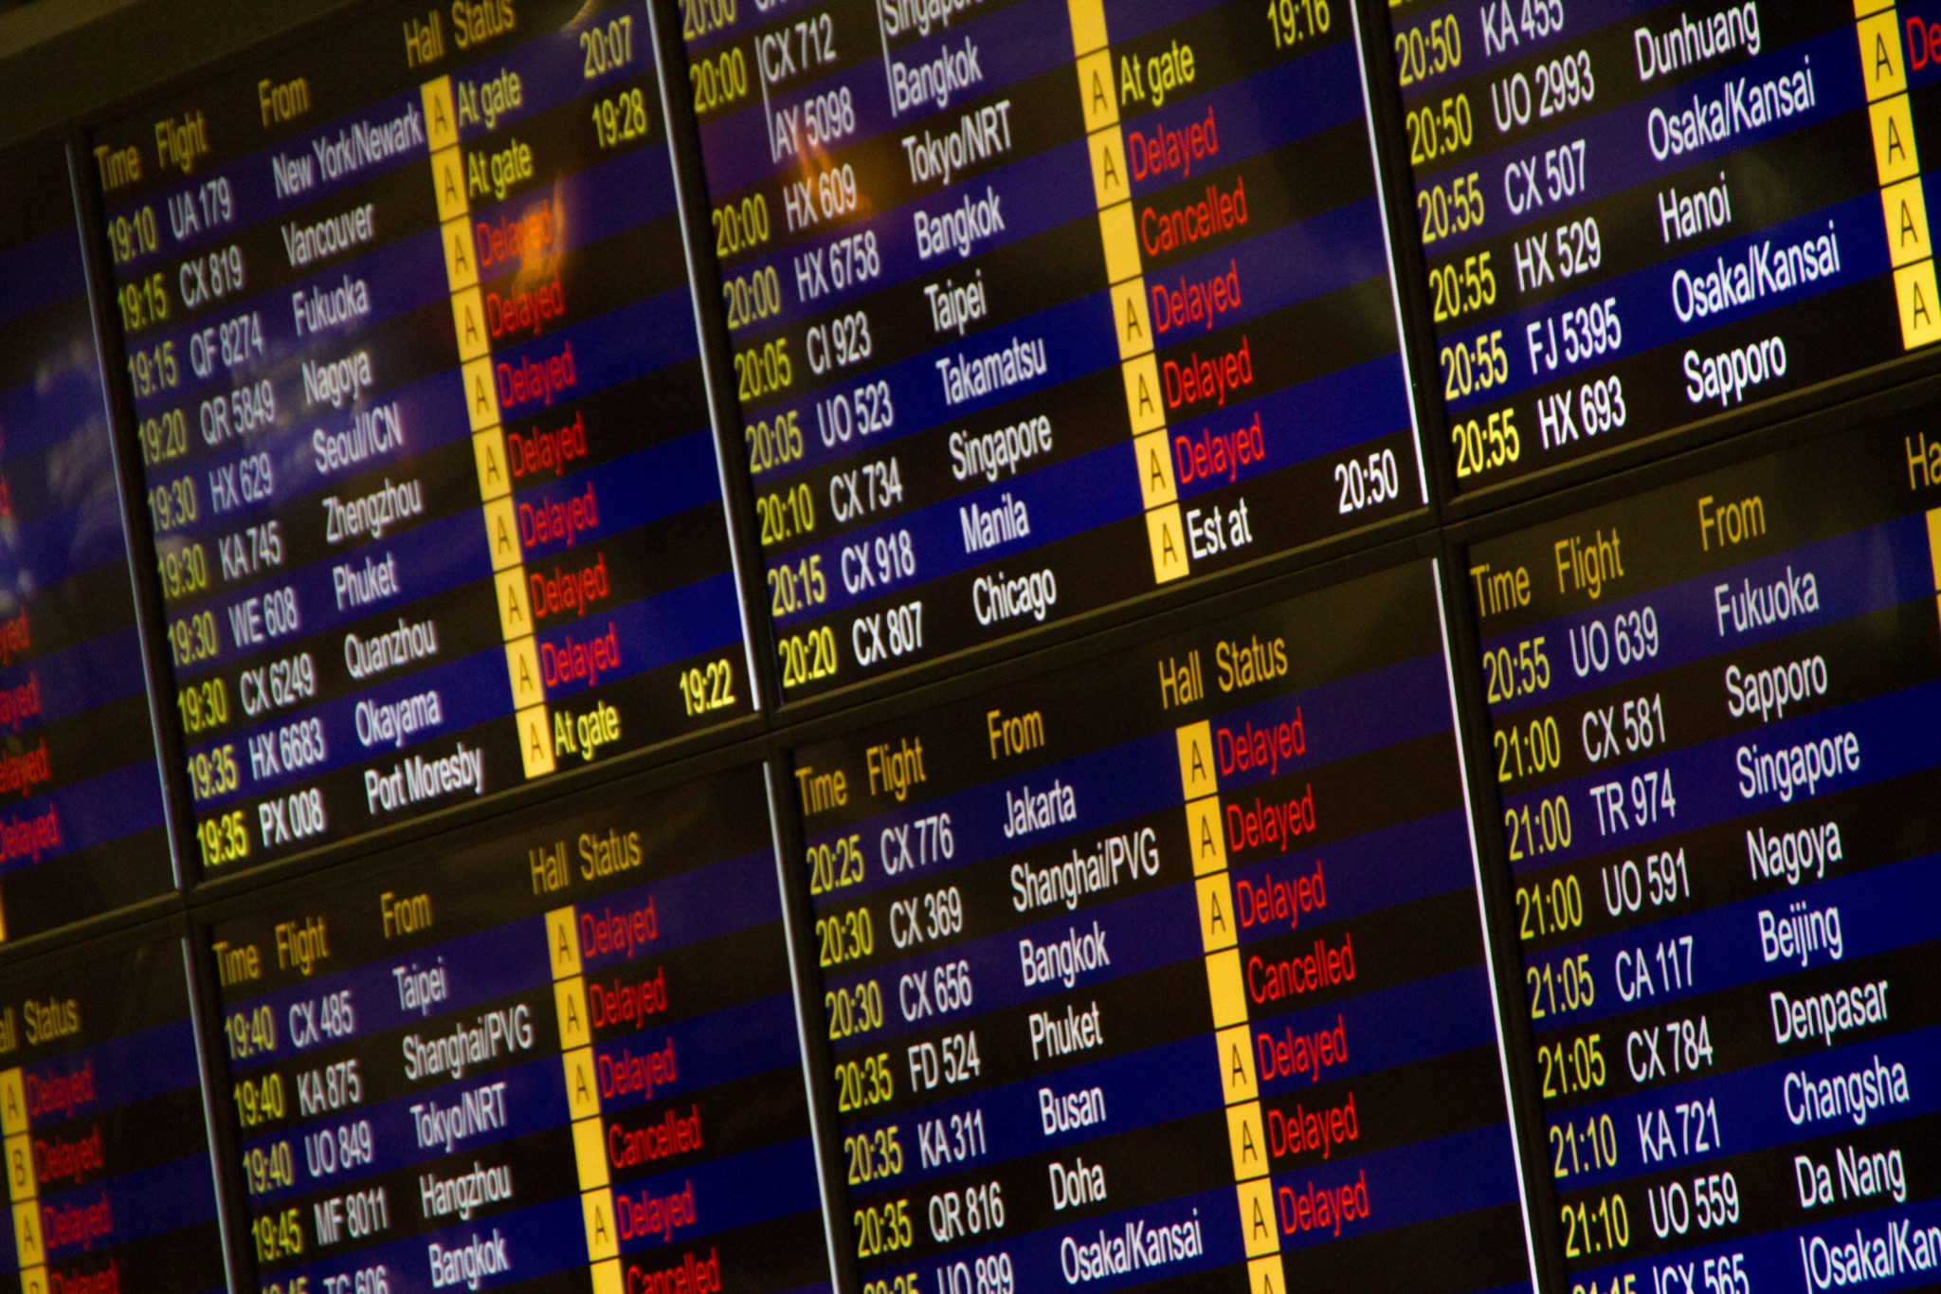
Dataset description
name
Airline Passenger Satisfaction
source
Kaggle.com, 2019
size
25900+ rows, 25 features
format
Comma Separated Values (CSV)
passenger features
age, gender, flight purpose
satisfaction features
global satisfaction, satisfaction of booking amenities (wifi service, seat comfort, food&drinks, etc.)
flight features
flight distance, flight delays

Slide 3



Dataset preparation
Missing Values
Only 1 column affected (flight arrival delay)
Only 0.3% rows affected
Replaced with flight departure delay (assumption: delay does not change in-flight)
Categorical Features
Flight type (Personal → 0, Business → 1)
Booking class (Eco → 0, Eco Plus →1, Business → 2)
Satisfaction (Satisfied → 1, Neutral or Dissatisfied → 0)
Binning of numerical Features
Flight departure and arrival delays cut in bins of 15 minutes

Slide 4
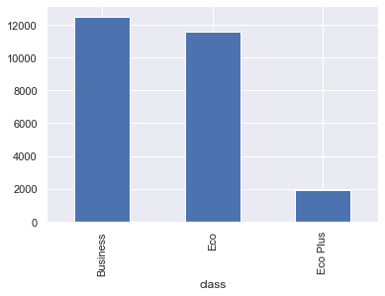
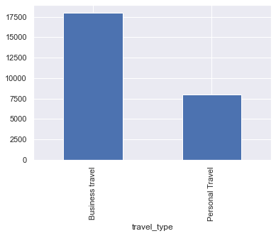
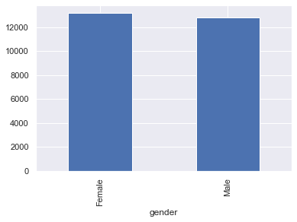
Basic characterisation
First thing I checked
Nearly 50-50 split between
Economy and Business class
(with few Economy+ bookings)
75% of trips are “business”, the remaining 25% are for “personal” reasons
Female-Male 50-50

Slide 5
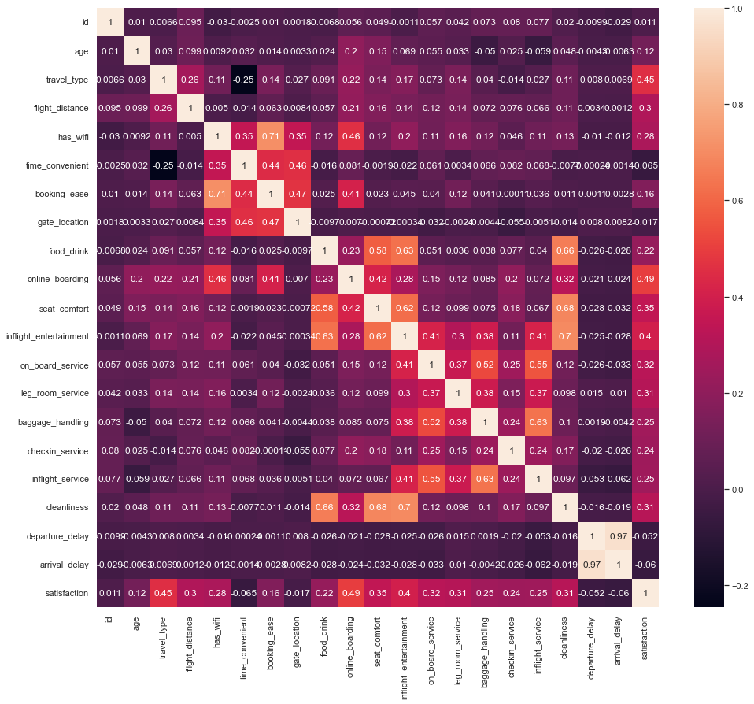

Features correlation
1st group of correlated features
wifi, time convenience, gate location
2nd group of correlated features
Food and drink, online boarding, seat comfort, inflight entertainment
3rd group of correlated features
Inflight entertainment, onboard service, leg room, baggage handling, checkin service, inflight service, cleanliness
If a passenger is satisfied of an item in each group, they will very likely be satisfied of the others too

Slide 6
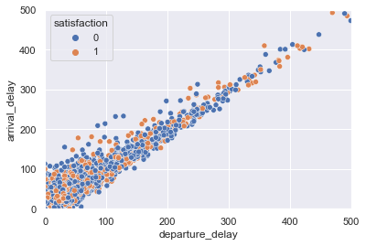
Delays vs global satisfaction
Observation 1
Without much surprise, departure and arrival delay seen to be strongly correlated
Observation 2
Correlation with global satisfaction (0 or 1)
is not so remarked
… let’s check better in the next slide

Slide 7
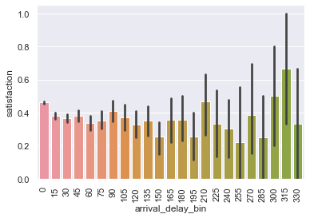
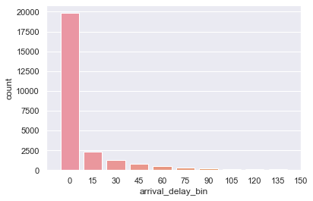
Arrival delay vs global satisfaction
The mean satisfaction for larger delays appears to be lower (expected), but the confidence interval is also much larger
Few records with extra-long delays (>180min)
Most flights have negligible delay (0-15min)

Slide 8
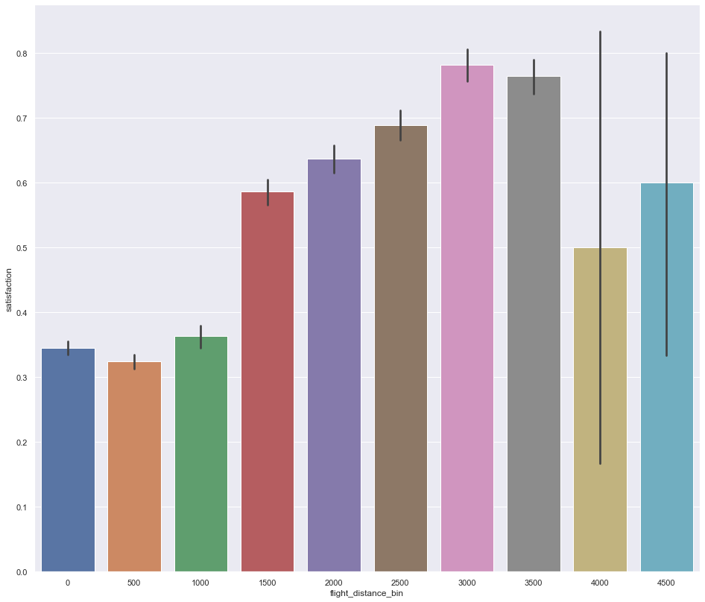
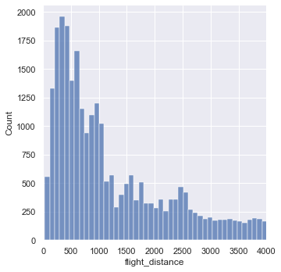
Flight distance vs global satisfaction
Longer flights are generally associated with higher satisfaction levels
(probably due to airline offering better amenities, such as food and drink)
Distribution of flight distance
75% of flights are short-haul (<1800Km)
Few records here

Slide 9
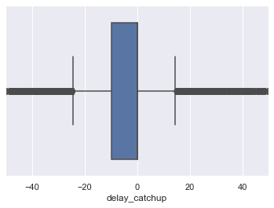
Delay Catchup
Relative difference between
arrival delay and departure delay
New feature created with using two existing features
Example
Departure delay: 60min
Arrival delay: 45min
Catchup
-25%
Observation
Airlines have limited ability to recover from a departure delay
No evidences of correlation between flight_catchup and flight_distance
-0.003

Slide 10
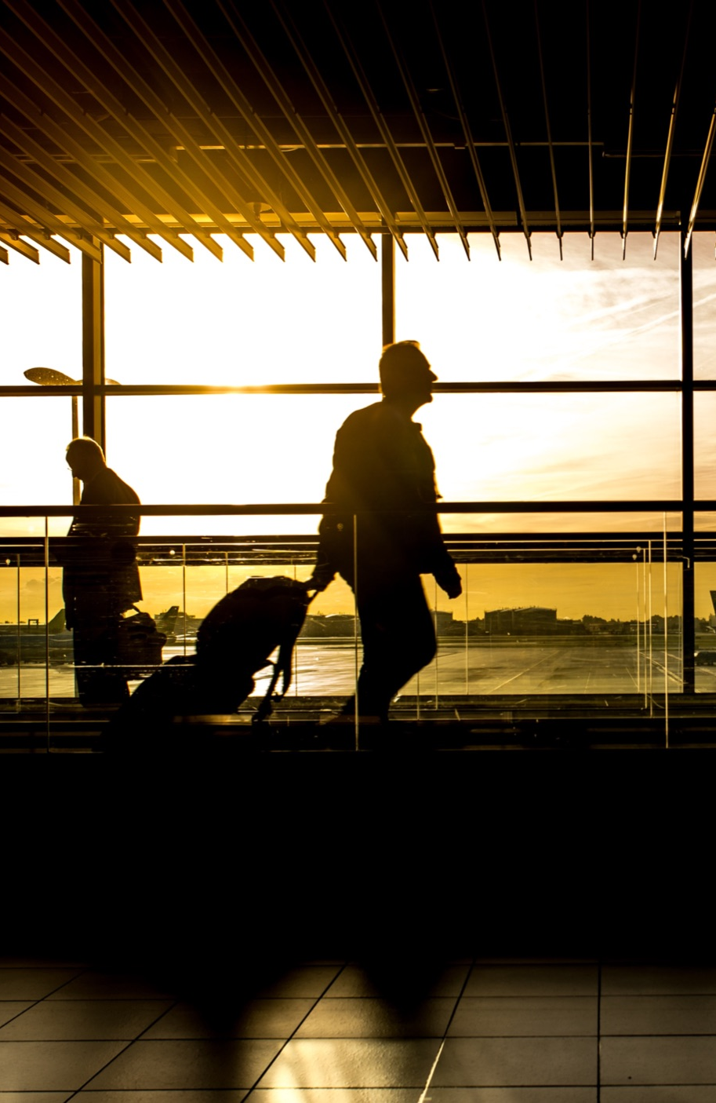
Conclusions
Satisfaction for flight services (entertainment, leg room, general inflight services) come together (passengers are satisfied of them all or none)
Surprisingly, flight delays do not impact global satisfaction of passengers
Airlines have limited ability to recover from a departure delay, even on long flights
Passengers tend to be more satisfied in longer flights
(generally they have better services)

Slide 11
Thank you
questions?

